Slide 1
DS 6050 – Deep Learning

Slide 2
DS6050 2nd Half Timeline
Module | Topic | Date
Module 7 | Sequence Modeling | 10/09
Project | Project Presentation - I | 10/16
Module 7-2 | Sequence Modeling - II | 10/23
Module 8 | Generative Learning | 10/30
Module 9 | Deep Reinforcement Learning | 11/06
Module 10 | Model Deployment | 11/13
Module 11 | Advanced Topics in DL Research | 11/20
 | Thanksgiving Break | 11/27
Module 12 | Transformer Networks | 12/04
Module 13 | Final Project Presentation | 12/11

Slide 3
Convolutional Neural Network (CNN) Applications
DS 6050

Slide 4
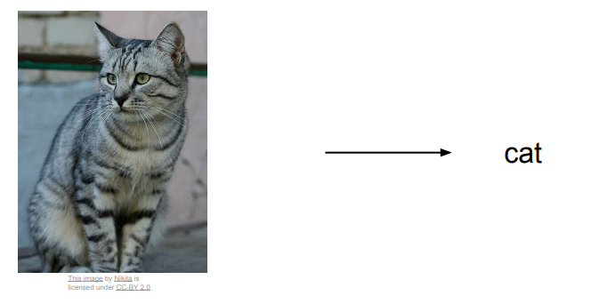
Image Classification

Slide 5

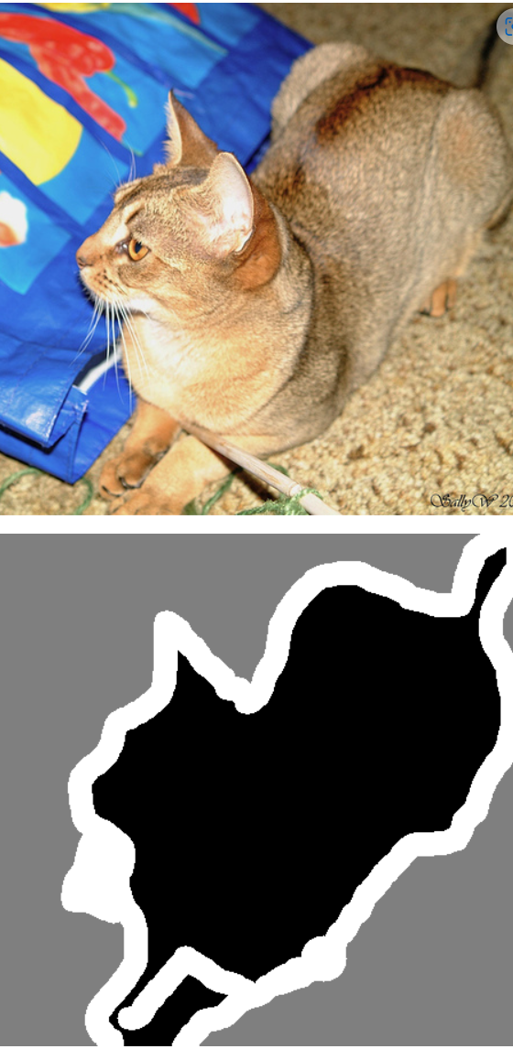
Image Segmentation
Image segmentation with a U-Net-like architecture (keras.io)

Slide 6
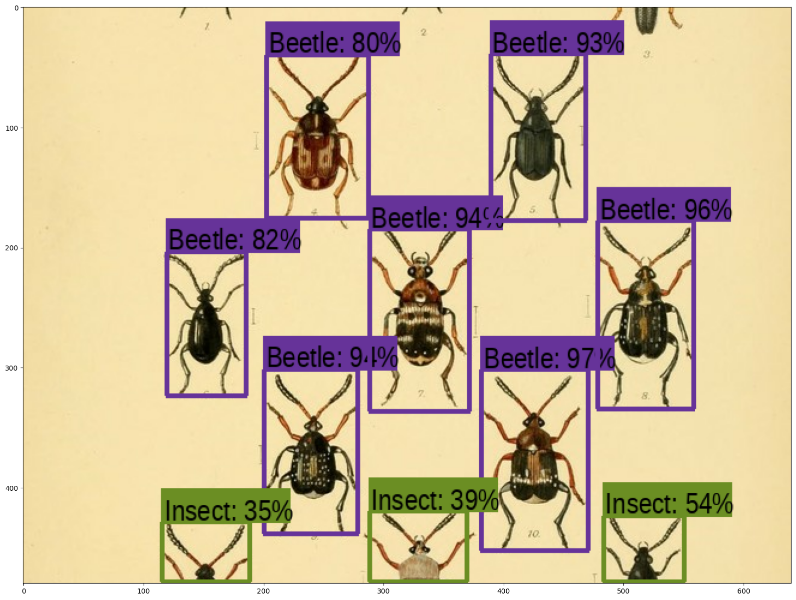
Object Detection
Object Detection with RetinaNet (keras.io)

Slide 7
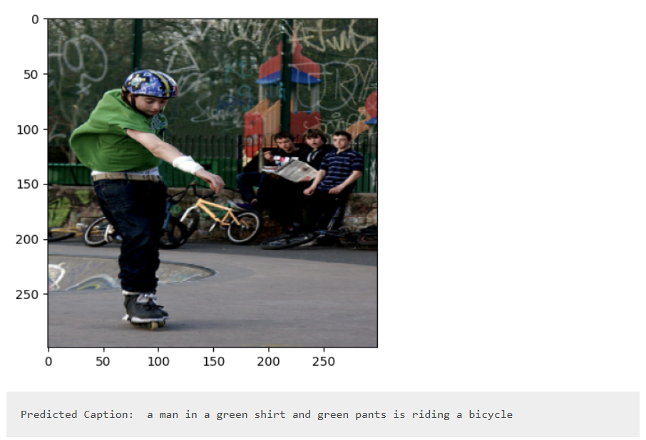
Image Captioning
Image Captioning (keras.io)

Slide 8
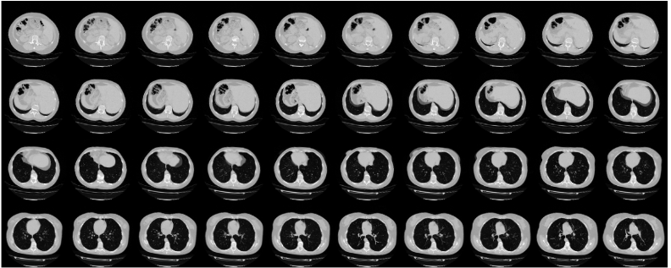
3D Classification
3D image classification from CT scans (keras.io)

Slide 9
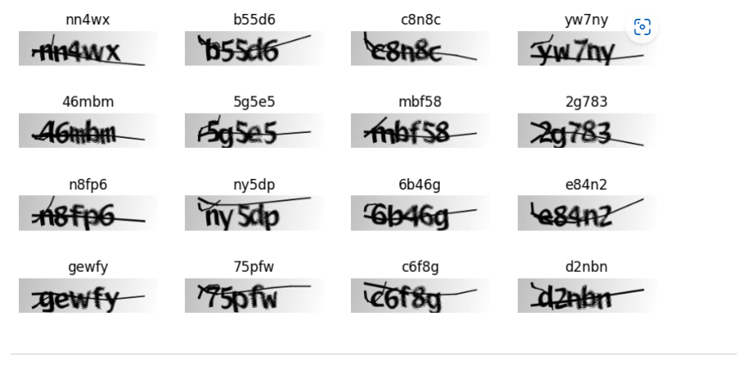
Optical Character Recognition (OCR)
OCR model for reading Captchas (keras.io)

Slide 10
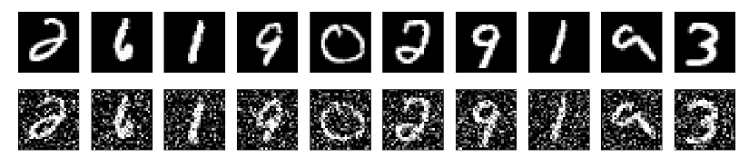
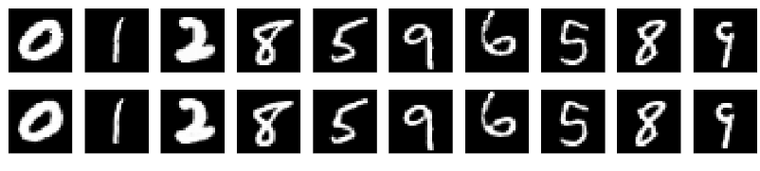
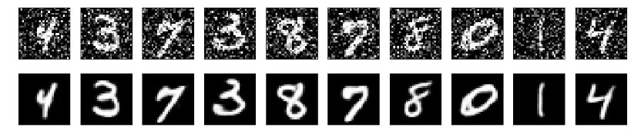
Image Enhancement
Train Data and
Train Data + Noise
Train Data + Label
Prediction
Convolutional autoencoder for image denoising (keras.io)

Slide 11
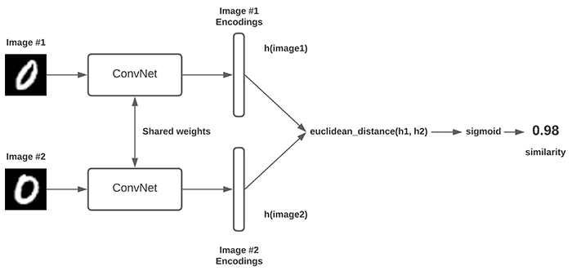
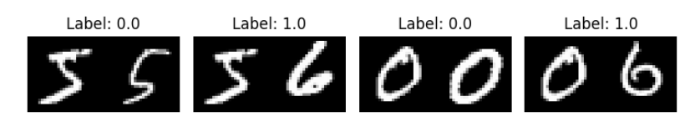
Image (Similarity) Search
https://keras.io/examples/vision/siamese_contrastive
https://keras.io/examples/vision/siamese_network

Slide 12
Video Processing
Video Classification with CNN-RNN Architecture
https://keras.io/examples/vision/video_classification
Action Recognition
https://www.tensorflow.org/hub/tutorials/action_recognition_with_tf_hub
Next Frame Video Prediction with CNN-LSTMs
https://keras.io/examples/vision/conv_lstm
Video Classification with Transformers
https://keras.io/examples/vision/video_transformers

